Slide 1
A (Cis) Man’s Place Is in This Session
No, Really, Come to This Session

Slide 2
Welcome.
You are in the right place.
(Whoever you are.)

Slide 3
And we are…
Ashley Belanger
Cherian Koshy
Heather Hill
Tycely Williams

Slide 4
A (cis)man’s place is calling out and calling in.

Slide 5
“But, I wouldn’t do that!”
You may be thinking that this doesn’t apply to you.
Most of us wouldn’t intentionally discriminate against or harass another person…
…however, there are many unintentional ways this can occur.

Slide 6
Intent vs. Impact - Microaggressions
Columbia University professor and leading psychologist Dr. Derald Wing Sue defines microaggressions as “the everyday verbal, nonverbal, and environmental slights, snubs, or insults, whether intentional or unintentional, which communicate hostile, derogatory, or negative messages to target persons based solely upon their marginalized group membership.”
People who commit microaggressions may not be aware of them, yet these types of incidents inhibit women from doing their best work, being optimally productive and undermine their success
Several research studies have also documented the adverse effect on mental health caused by microaggressions

Slide 7
What are examples of microaggressions?
Microassaults –overt and verbal or behavioral. Name calling, avoidance, telling sexist jokes
Microinsults — subtle snubs that convey stereotypes, rudeness or insensitivity. Asking women to be the secretary/notetaker, taking over physical space
Microinvalidations — minimalizing or dismissing lived experience. Attributing success to gender or appearance, ignoring women’s contributions in a meeting

Slide 8
Recognition and Response
Awareness of microaggressions—yours and those of others—is the first step. But, how do you respond?
  Choose your moment – either “calling out” in the moment or “calling in” through a follow-up conversation
  Choose your participants – is this a conversation you can have, or are there others who should be involved?
  Choose your approach – ask questions (eg ”Help me understand what you meant by…?”), discuss intent vs. impact, correct the inappropriate behavior

Slide 9
A (cis)man’s place is recreating the system.

Slide 10
The 4 “I”s of Oppression: The System We Live In
Ideological Oppression
At some level, we believe [white cis hetero] men are better.
Institutional Oppression
If we believe [white cis hetero] men are better, then we make it so.
Interpersonal Oppression
If we make it so, then we normalize the disadvantage of women.
Internalized Oppression
If we normalize the disadvantage of women, we eventually adopt the dominant ideology ourselves.

Slide 11
The System Reinscribes Itself, But Only If We Let It
According to AFP’s 2018 study, about 25% of female fundraisers have experienced sexual harassment on the job…
96% of the perpetrators were men… 70% of perpetrators held positions of power.
Only 43% of victims reported to the organization.
Loads of research outside of the field shows time and again that sexual harassment & sexual assault are grossly underreported.

Slide 12
No one of us is at fault.
But individual actions do have ripple effects…
And each of us is part of the way forward
… To where we each get to live fully into who we are.

Slide 13
A (cis)man’s place is better mentoring and sponsoring.

Slide 14
The Issue
Gender disparities in professional growth opportunities
Importance of mentorship and sponsorship for career advancement

Slide 15
Strategies for Better Mentorship
M: Mindful of biases
  Educate oneself on gender biases
  Reflect on and challenge one's own assumptions
E: Engage women in mentoring relationships
  Actively seek out women to mentor
  Provide guidance and support tailored to their needs
N: Nurture diverse networks
  Foster connections between women and other professionals
  Create opportunities for women to expand their networks
T: Take responsibility for sponsorship
  Be intentional about sponsoring women
  Advocate for women's career advancement within the organization
O: Openly promote women's accomplishments
  Share and celebrate women's successes
  Ensure women receive recognition for their contributions
R: Recognize and address barriers
  Understand the unique challenges women face in the workplace
  Work together to dismantle systemic barriers to women's advancement

Slide 16
Conclusion
The importance of men's involvement in promoting gender equity
The benefits of diverse and inclusive workplaces for all
Commitment to being better mentors and sponsors for women

Slide 17
And now,
a little bit of theatre…

Slide 18
A (cis)man’s place is self-reflection.

Slide 19
5 Stages & Tips for Self-Reflection
Reporting
Responding
Relating
Reasoning
Reconstructing

Slide 20
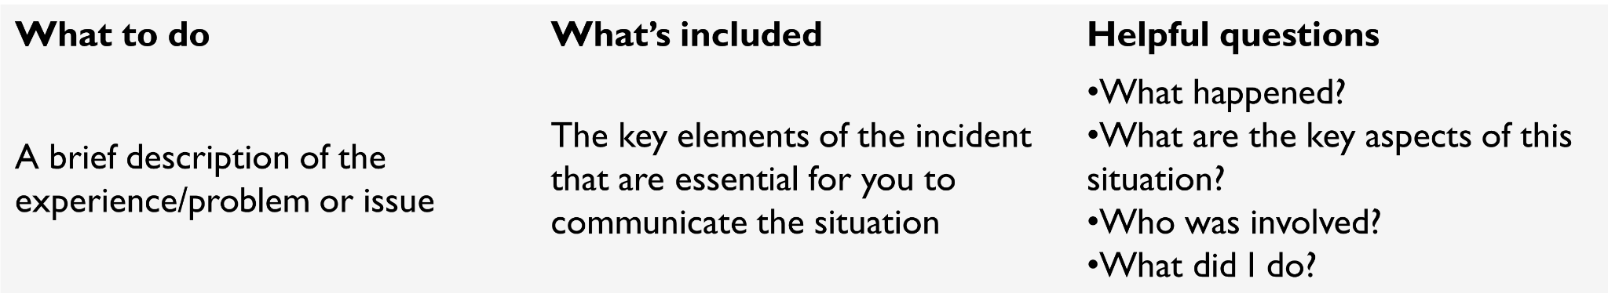
Reporting

Slide 21
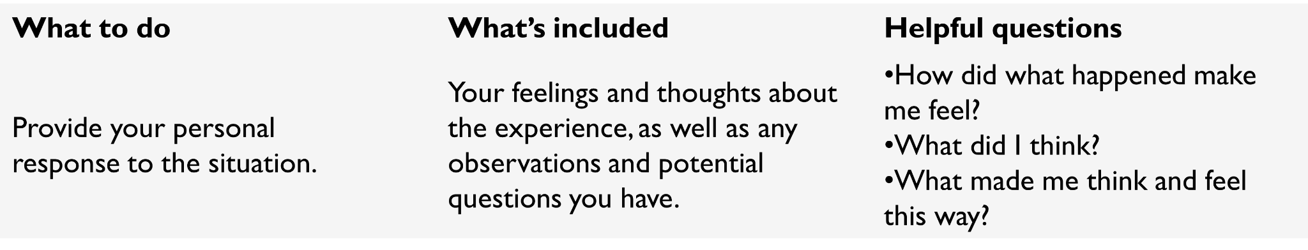
Responding

Slide 22
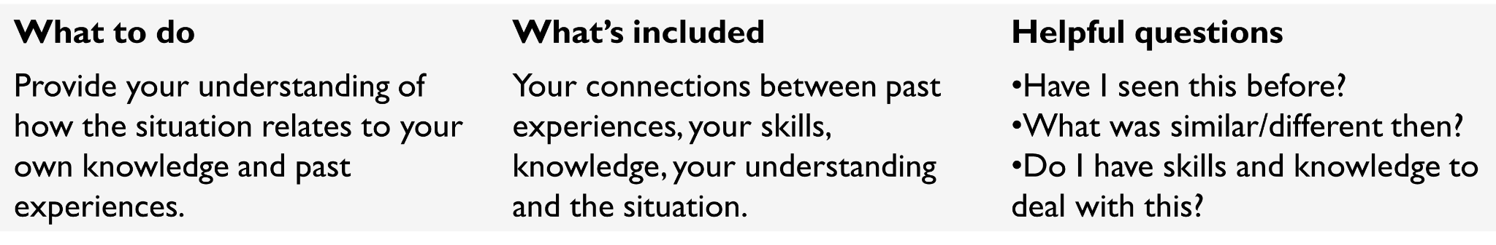
Relating

Slide 23
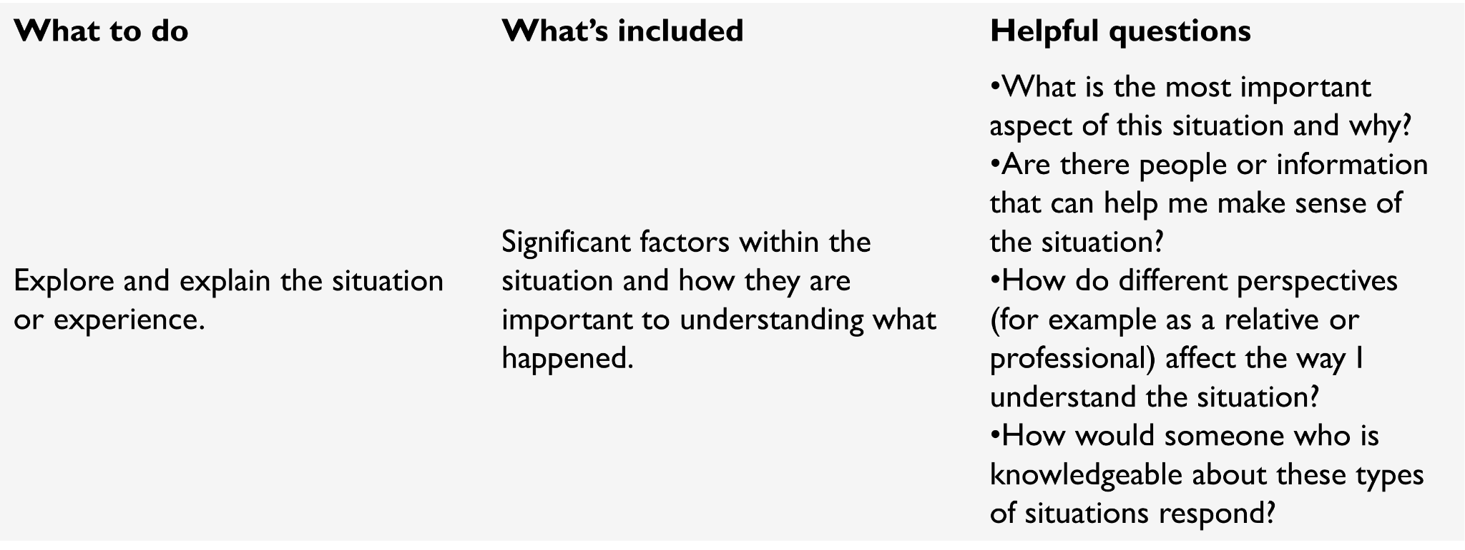
Reasoning

Slide 24
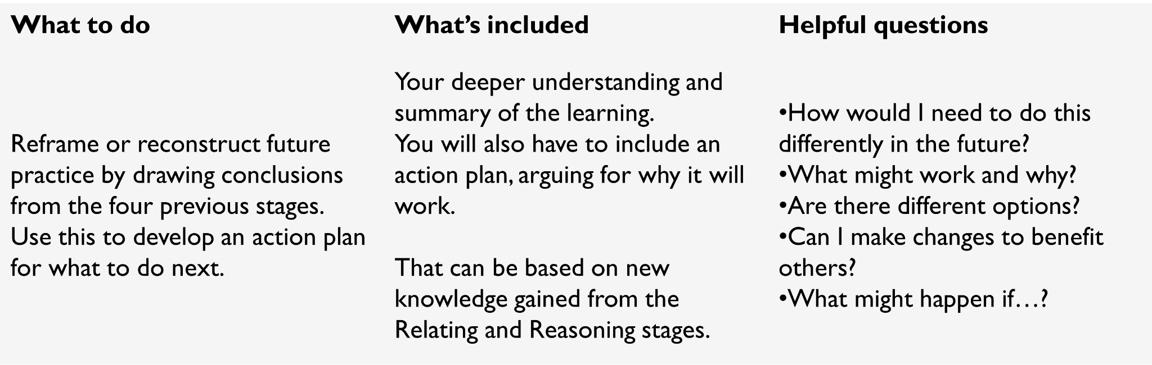
Reconstructing

Slide 25
Everyone’s place is committing to action.

Slide 26
Thank you.

